Slide 1
Text-to-Video Generation through
Advanced Stable Diffusion Models
Arnab Halder (ash186) Ashwin Patil (aap327)
Harvish Jariwala (hj389)
Jay Patil (jsp255)
Sanchay Kanade (sk2656)
Notes:
Hello everyone! Today we will be presenting on Text-to-Video Generation through Advanced Stable Diffusion Models.

Slide 2
Problem Statement
Core Challenge:
While text-to-image generation using AI models like Stable Diffusion has made significant progress, directly generating videos from textual descriptions remains a complex and cutting-edge area of research.
Problem Setting:
We focus on the domain of short-form video generation based on simple textual descriptions. Ideally, we'd like the flexibility to influence the video style with an additional reference video (but this is an optional advanced feature).
Notes:
[Core Challenge]
Generating videos from text has been a big aim in AI, but it's been tougher than generating images. Though text-to-image models like Stable Diffusion have improved a lot, generating videos directly from text is still an active area of research.
[Problem Setting]
We're focusing on generating short videos based on simple text. Our aim is to describe scenes or actions in text and turn them into videos. Users can also add a reference video to help set the style and mood of the new video, which gives them more control.
By working on these challenges, we're aiming to push the boundaries of AI creativity and make content creation tools easier and more flexible.

Slide 3
Motivation
Challenges with T2V
Lack of large-scale datasets with high-quality text-video pairs.
Complexity of modelling higher-dimensional video data.
Vagueness around video captioning.
Notes:
[Motivation]
Text-to-video (T2V) generation has great potential to change how we create content. However, there are tough challenges we need to overcome to make this happen.
[Challenges with T2V]
##Lack of large-scale datasets with high-quality text-video pairs:
One of the primary obstacles is the scarcity of large-scale datasets that pair high-quality textual descriptions with corresponding video content. Without access to such datasets, training robust T2V models becomes significantly more challenging.
##Complexity of modeling higher-dimensional video data:
Unlike images, videos have a lot more information to deal with. This makes modeling them harder. T2V systems need to understand temporal dynamics, scene transitions, and other nuanced elements inherent in video content which requires sophisticated architectures and training methodologies.
Figuring out video descriptions is tricky:
Turning these descriptions into clear and accurate visual sequences is a big challenge, especially when the descriptions are abstract or unclear.

Slide 4
Prior Work
First wave of text-to-image models, including VQGAN-CLIP, XMC-GAN, and GauGAN2.
Followed by OpenAI's transformer-based DALL-E in early 2021.
New wave of diffusion models pioneered by Stable Diffusion with DALL-E2 in 2022.
Shift from GANs to Diffusion Models.
Generating video is still challenging.
Notes:
Slide 1: Prior Work in Text-to-Video Generation
##[Early Text-to-Image Models]
The journey to create content from text started with models like VQGAN-CLIP, XMC-GAN, and GauGAN2. They showed how to translate text descriptions into clear visual representations, laying the foundation for future improvements.
##[Transformer-Based Models]
OpenAI's DALL-E, revealed in early 2021, was a big step in turning text into images. Using transformer structures, DALL-E generated diverse and high-quality images from text instructions.
##[Rise of Diffusion Models]
Around 2022, a new set of models, led by Stable Diffusion with DALL-E2, came up. They moved away from the usual GAN methods to diffusion models.
##[Challenges in Making Videos]
Even with progress in generating images from text, generating videos from text is still very hard. Moving from still images to videos adds more difficulty, like capturing temporal dynamics and maintaining coherence over time. Solving these problems is crucial for making text-to-video work well and improving AI content creation.

Slide 5
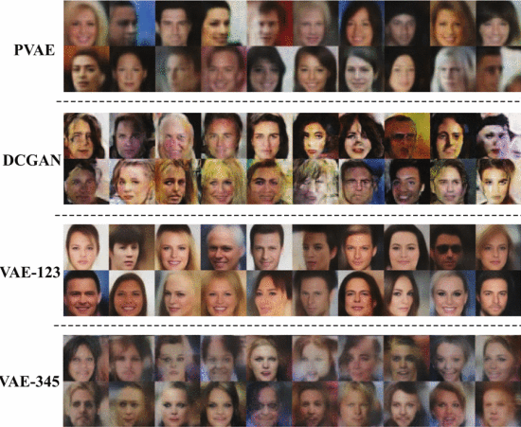
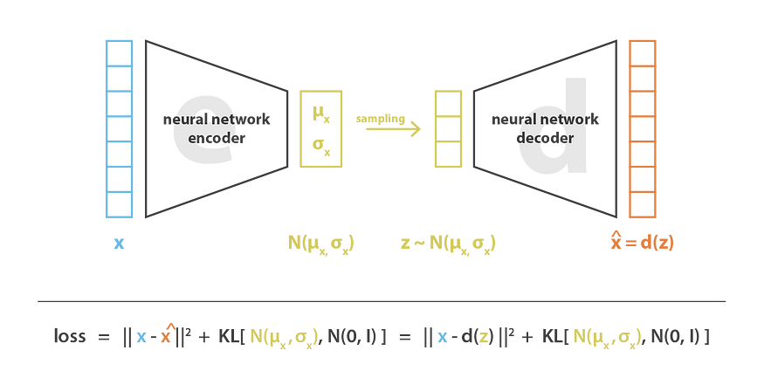
VAE
Encoder, a decoder, and a latent.
Encoder: Input data -> latent space.
Decoder: Latent space representation -> Data Space.
Effective in image generation and data compression.
Notes:
· Variational Autoencoders are different from traditional autoencoders in the sense that they can generate new data points with variations that are likely drawn from the same distribution as the training data, using Probabilistic Encoding.
· They consist of an encoder, a decoder, and a latent layer in between.
Encoder maps the input data to a lower-dimensional latent space representation .
The latent layer is a probabilistic space that captures the underlying structure of the input data in a more efficient and interpretable way
Decoder maps the latent representation back to the original data space.
Effective in image generation and data compression
Disadvantage is it struggles with high dimensional data like videos.
Compression and decompression might lead to loss in information.
Quality of generated content is poor compared to other solutions.
High dimension means apart from 2d images there is a temporal dimension as well which makes it a video
Latent layer allows for the generation of new data samples by sampling from the learned distribution in the latent space

Slide 6
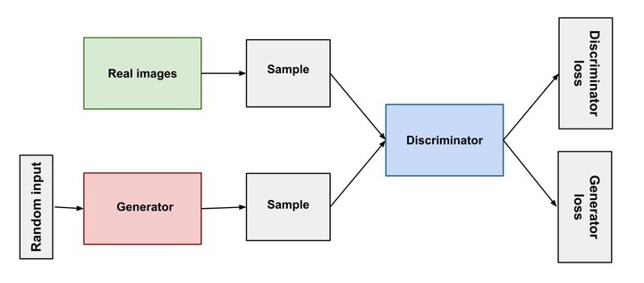
GAN
Two main components:
Generator: takes in random noise vector and fake data samples.
Discriminator: attempts to distinguish between fake and real data samples.
Notes:
Generative Adversarial Network: is a system of two neural networks contesting with each other in a game-theoretic framework.
Two main components are:
Generator: takes in random noise vector and generates fake data samples which are indistinguishable
Discriminator: attempts to distinguish between fake and real data samples
These two components are trained simultaneously.
It is an adversarial process where the generator and discriminator are trained simultaneously in a zero-sum game.
Each get better as they are trained as adversaries to each other
The typical loss function used in a GAN is formulated as a min-max game between the generator and discriminator
What do you mean by adversaries?
GANs can generate realistic images that can be indistinguishable from real images.
Some of the challenges of GAN’s are:
GANs are notoriously difficult to train. The training process can be unstable and often results in mode collapse (where the generator produces limited varieties of samples).
It is difficult to evaluate the performance of GANs since there's no explicit loss function that indicates the quality of the generated data.

Slide 7
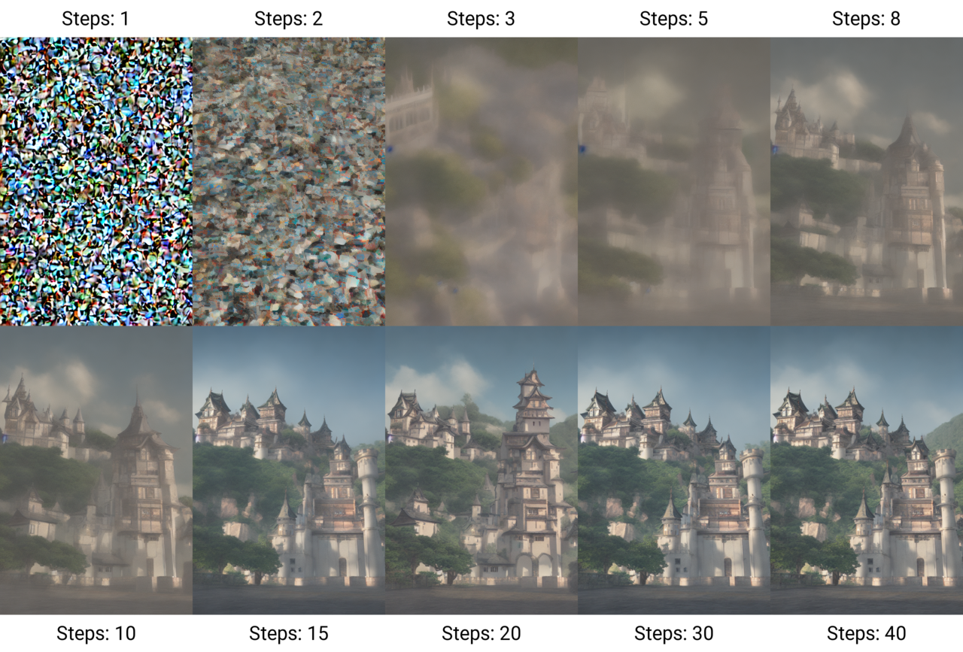
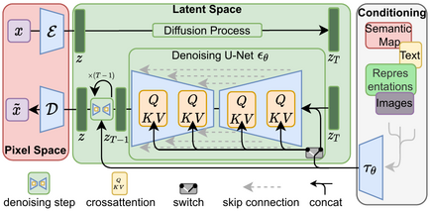
Advanced diffusion model
Diffusion model
Stable Diffusion
Advanced Stable Diffusion
Notes:
A diffusion model is a type of generative model that learns to create data resembling a given distribution.
Diffusion is a two step process:
Forward Process (Adding Noise): By the end of this process, the original data is completely transformed into Gaussian noise.
Reverse Process (Generating Data): The model is trained to predict earlier, less noisy versions of the data, given a noisier version. Essentially, it learns to denoise step by step, starting from pure noise and gradually reconstructing the data.
Unlike traditional diffusion models that operate directly in the pixel space, Stable Diffusion Models, operates in a compressed latent space. This allows the model to be more efficient and faster in generating images, as operating in latent space requires manipulating significantly fewer data points compared to the pixel space.
Advanced Stable Diffusion in our context refers to the enhancement of pre-trained diffusion models to extend their capabilities from image to video generation, introducing a novel, efficient method that leverages the intrinsic strengths of T2I models for dynamic and contextually rich video content creation.

Slide 8
Input and Output
Input:
Primary: A text prompt (e.g., "A cat chasing a mouse through a garden").
Optional: A short reference video to guide the style of the generated output.
Output:
A short video clip that visually aligns with the provided text prompt and optionally reflects the style of the reference video.

Slide 9
Method
Framework:
Tune-A-Video
Technique :
Model Fine-tuning (Training):
Inference (Generation):
Notes:
We use the Tune-A-Video framework, which builds upon the capabilities of pre-trained Stable Diffusion models
We fine-tune a pre-trained Stable Diffusion model using a video dataset paired with relevant textual descriptions. This trains the model to associate video frames with their textual counterparts.
Once fine-tuned, we feed new text prompts into the model. The model, guided by its learned understanding, generates video frames that progressively build up a whole video sequence.

Slide 10
Overview
Pre-trained T2I diffusion models.
Requires only one text-video pair for training.
Significantly reducing the computational expense.
Extended this model to generate videos.
Notes:
This method leverages large pre-trained T2I diffusion models to generate videos from text descriptions
This approach is unique because it requires only one text-video pair for training, significantly reducing the computational expense typically associated with training video generation models.
By extending these models to handle multiple images and temporal sequences, they create a system that can generate videos that are consistent in content across frames and demonstrate continuous motion.

Slide 11
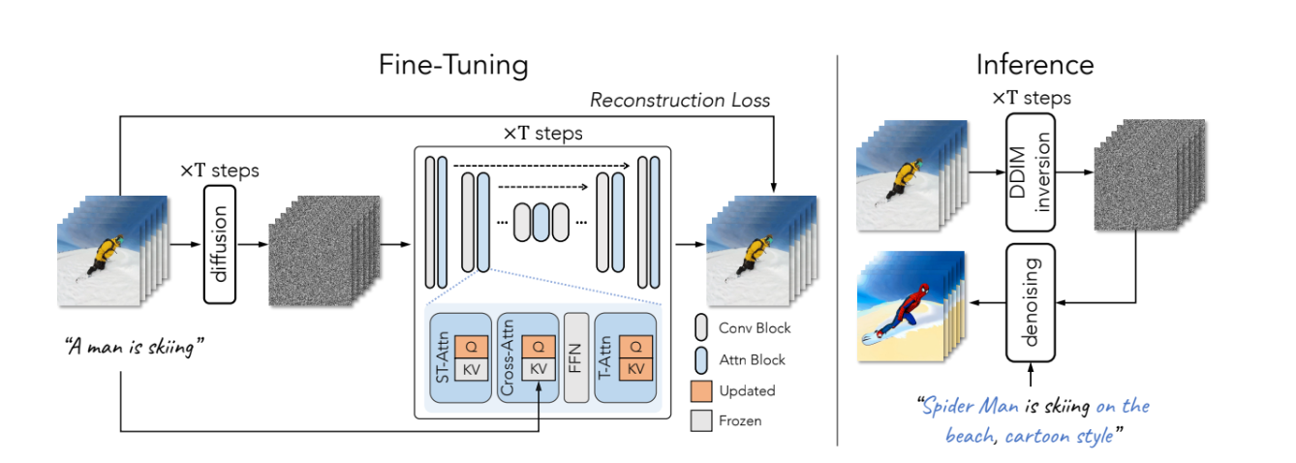
Architecture
Input Preparation
Pre Trained T2I Diffusion Model
Fine-Tuning
DDIM Inversion
Inference and video generation
Output
Notes:
So yeah, lets talk a little about the architecture. Here
Input: The input to Tune-A-Video is a pair consisting of a textual description and a corresponding video. For example, the textual description here is "a man is skiing".
Pretrained T2I Diffusion Models: Tune-A-Video leverages pretrained Text-to-Image (T2I) diffusion models. These models are trained to generate realistic images from textual descriptions. In this case, the models are adapted to generate videos from textual descriptions (T2V generation).
Fine-Tuning: Fine-tuning is a process where the model learns to better understand and generate videos based on the provided textual descriptions. The diffusion training loss is a specific type of loss function used during training to guide the model's learning process. During the fine-tuning stage, the model updates the projection matrices in attention blocks using the standard diffusion training loss.
Inference: During the inference stage, which is when the model is generating videos based on new inputs, a novel video is sampled from the latent noise inverted from the input video. Latent noise refers to the random noise added to the input data, and inverting it involves finding the original latent representation of the data. This process allows the model to generate diverse outputs. The sampling process is guided by an edited prompt, which is a modified version of the original textual description. For example, the prompt here is "Spider Man is surfing on the beach, cartoon style".

Slide 12
Modifications
We have tried to imitate the architecture of author’s implementation. However, we have made following changes :
Due to constraints in memory and compute:
Decreased number of frames in decoder output from 16 to 12.
Increased frame skip in frame interpolation network from 3 to 5.
For fine tuning the attention blocks we have used our own dataset
Notes:
Modifications done:
We have tried to imitate the architecture of author’s implementation. However, we have made following changes :
Due to constraints in memory and compute:
Decreased number of frames in decoder output from 16 to 12.
Reduced frame skip in frame interpolation network from 5 to 3.
For fine tuning the attention blocks we have used our own dataset
So, essentially we wanted to study how the output would change if we scale down our architecture and train it on our own dataset

Slide 13
Dataset
We have only trained the temporal part of the dataset (attention block)
Unlabeled video data
Animal Kingdom: We have used Animal Kingdom dataset for animal action recognition, which has about 50 hours of video data consisting of around 100 animal species and 140 action categories.
UCF101: We have also used UCF101 that consists of about 13k videos belonging to around 100 action classes.
Evaluation
Kinetics: We used 20-25 samples from Kinetics dataset for generating video samples and compare the original videos with the generated videos
Notes:
Animal Kingdom dataset is a structured collection of images intended for use in training machine learning models to recognize various animal species. Here are its key features:
Scale: It includes thousands of high-quality images of animals.
Diversity: The dataset covers a wide range of animal species from different habitats and regions.
Annotations: Each image is annotated with the species name and sometimes additional information such as the habitat or behavior.
Applications: It's used primarily in biodiversity research, ecological studies, and for developing automated animal recognition systems.
Utility: Helps in advancing computer vision techniques in the field of natural sciences, aiding in species identification and conservation efforts.
This dataset plays a crucial role in the intersection of technology and wildlife conservation, facilitating the development of tools for automatic species recognition and ecological research.
UCF101 dataset: is a widely-used collection of video clips designed for action recognition research in machine learning. Here are its key features:
Scale: Contains 13,320 videos from 101 action categories.
Diversity: Features a broad range of human activities, including sports, playing musical instruments, and daily activities.
Annotations: Each video is annotated with the specific action being performed.
Format: Videos are typically short clips that provide a focused glimpse of a single action.
Usage: Developed by the University of Central Florida, it is extensively used for benchmarking action recognition and machine learning algorithms.
The UCF101 dataset is crucial for developing and evaluating video understanding systems, particularly in the context of recognizing complex, dynamic human activities.
Kinetics dataset is a large collection of video clips designed for training machine learning models in human action recognition. Here are its key features:
Scale: Contains hundreds of thousands of 10-second video clips from YouTube.
Diversity: Features a wide range of human activities categorized into several hundred classes.
Annotations: Each video is labeled with the action being performed.
Versions: Includes versions like Kinetics-400, Kinetics-600, and Kinetics-700, indicating the number of action classes.
Usage: Developed by DeepMind, it's widely used in computer vision research to benchmark action recognition algorithms.
The dataset is essential for advancements in video analysis and understanding dynamic human activities.

Slide 14
Results
Fig. 1: Result generated when provided a prompt of ‘a cat is playing guitar’

Slide 15
Fig. 2: Result generated when provided a prompt of ‘Superman is skiing’

Slide 16
Method | Frame Consistency (CLIP Score) | Textual Alignment (CLIP Score)
Our Method (Implementation) | 88.1 | 25.3
One Shot Tuning | 92.4 | 27.58
Table 1: CLIP scores for frame consistency and textual alignment for One Shot Tuning and our method
We could observe that our scores were a little less than that of authors implementation since we had to do some modifications in our architecture due to resource constraints and limited data

Slide 17
Fig. 2: Result generated when provided a prompt of ‘Rabbit is surfing, cartoon style’
As can be seen above, the face appears to be little distorted or not smooth as described in previous slide

Slide 18
Lessons Learned
Future Work:
Architecture changes
Increase number of frames in decoder
Use Spatio-temporal super-resolution from Make-a-video
Scaling Up:
Explore larger datasets
More powerful state-of-the-art model architectures
Complex Actions:
Address generating longer videos
More intricate interactions described in the prompts
Style Control:
Refine techniques for more nuanced influence on the stylistic qualities of generated video.
Notes:
Scaling Up: We faced a significant hardware limitation while attempting to train on Kinetics dataset. It contains 500k videos which requires a lot of computing power. This was unfortunately out of scale for our school project
Complex Actions: Our testing criteria was limited. It consisted of limited number of phrases used to generate the videos. Additionally, we only generated shorted videos with limited frame rates. A more complex and advanced architecture would probably help us with these challenges
Style Control: This is a more open ended challenge. We could be artistic, for example, Sora’s recent demo had cyberpunk like themes, different POVs and different types of worlds. Moving to a complex architecture could help us do that. Or we could have different neural networks following the main just for this sort of style control.

Slide 19
References
Jay Zhangjie Wu, Yixiao Ge, Xintao Wang, Stan Weixian Lei, Yuchao Gu, Yufei Shi, Wynne Hsu, Ying Shan, Xiaohu Qie, Mike Zheng Shou; Proceedings of the IEEE/CVF International Conference on Computer Vision (ICCV), 2023, pp
Rajat Arora and Yong Jae Lee. Singan-gif: Learning a generative video model from a single gif. In Proceedings of the IEEE/CVF Winter Conference on Applications of Computer Vision, pages 1310–1319, 2021. 3
Ming Ding, Wendi Zheng, Wenyi Hong, and Jie Tang. Cogview2: Faster and better text-to-image generation via hierarchical transformers. arXiv preprint arXiv:2204.14217, 2022. Chen, Haoxin, et al. "Videocrafter2: Overcoming data limitations for high-quality video diffusion models." arXiv preprint arXiv:2401.09047 (2024).
Khachatryan, Levon, et al. "Text2video-zero: Text-to-image diffusion models are zero-shot video generators." arXiv preprint arXiv:2303.13439 (2023).
Uriel Singer et al. “Make-A-video: Text-to-video generation without text-video data.”, Sept. 2022
A beginner’s guide to language models. URL: https://builtin.com/data- science/beginners-guide-language-models.
Xiangyu Chen et al. Activating more pixels in image Super-Resolution Transformer. Mar. 2023.URL: https://arxiv.org/abs/2205.04437.

